Slide 1
January 31, 2022
Optum Care Detailed Program View
Owner
Jaffer Mohammed, Arnab Jana, Ryan Nishimoto, Tech Financial Ops Team, The Data
Squad, Louis A. Boney

Slide 2

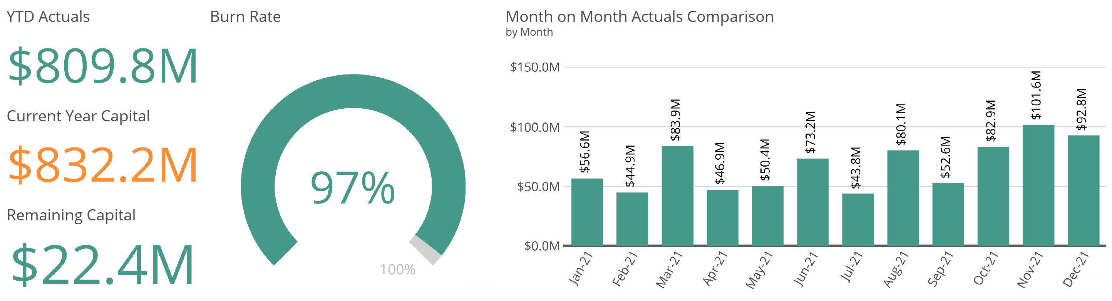

Slide 3
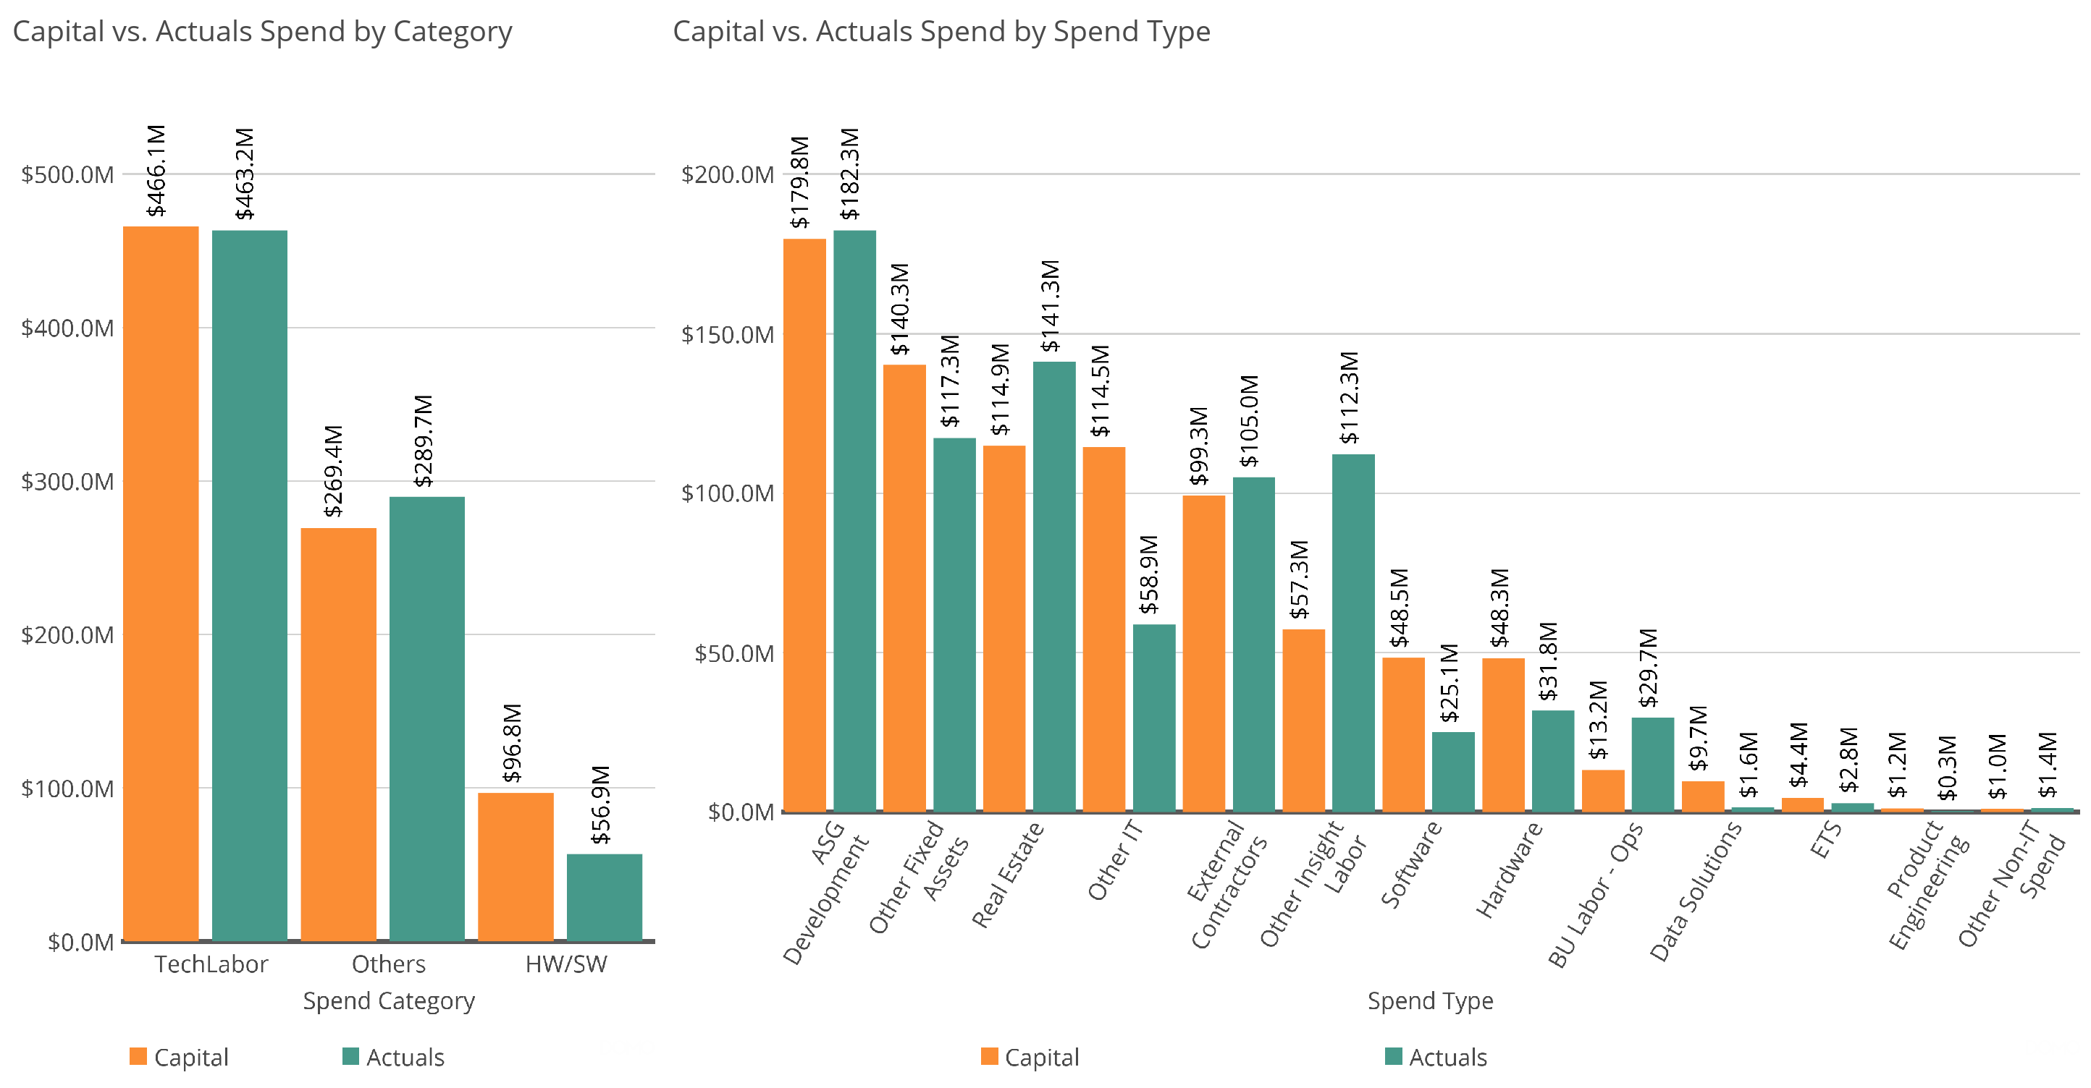

Slide 4
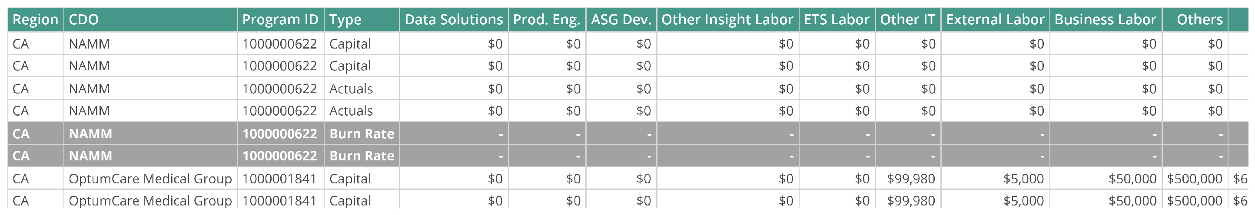
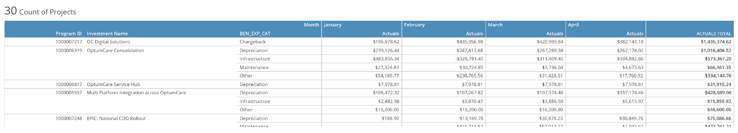
Program Capital
Operational Expense Summary

Slide 5
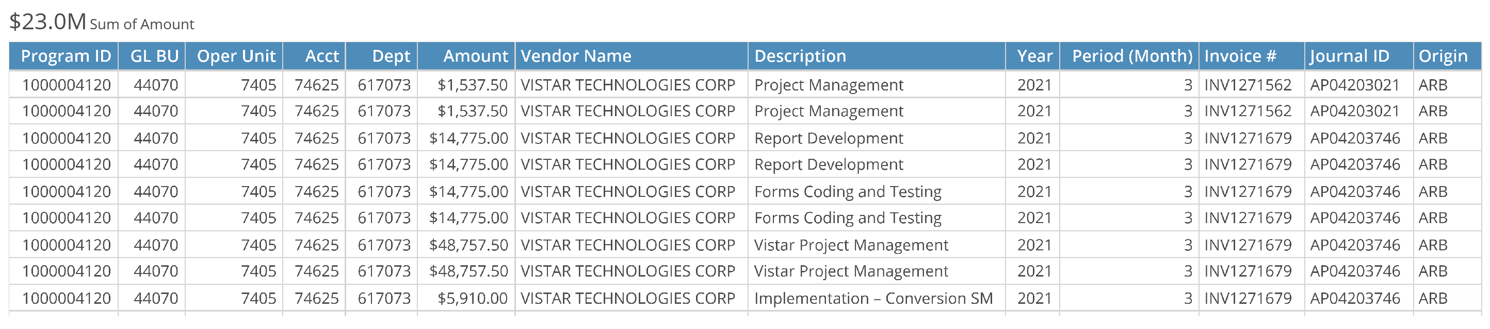
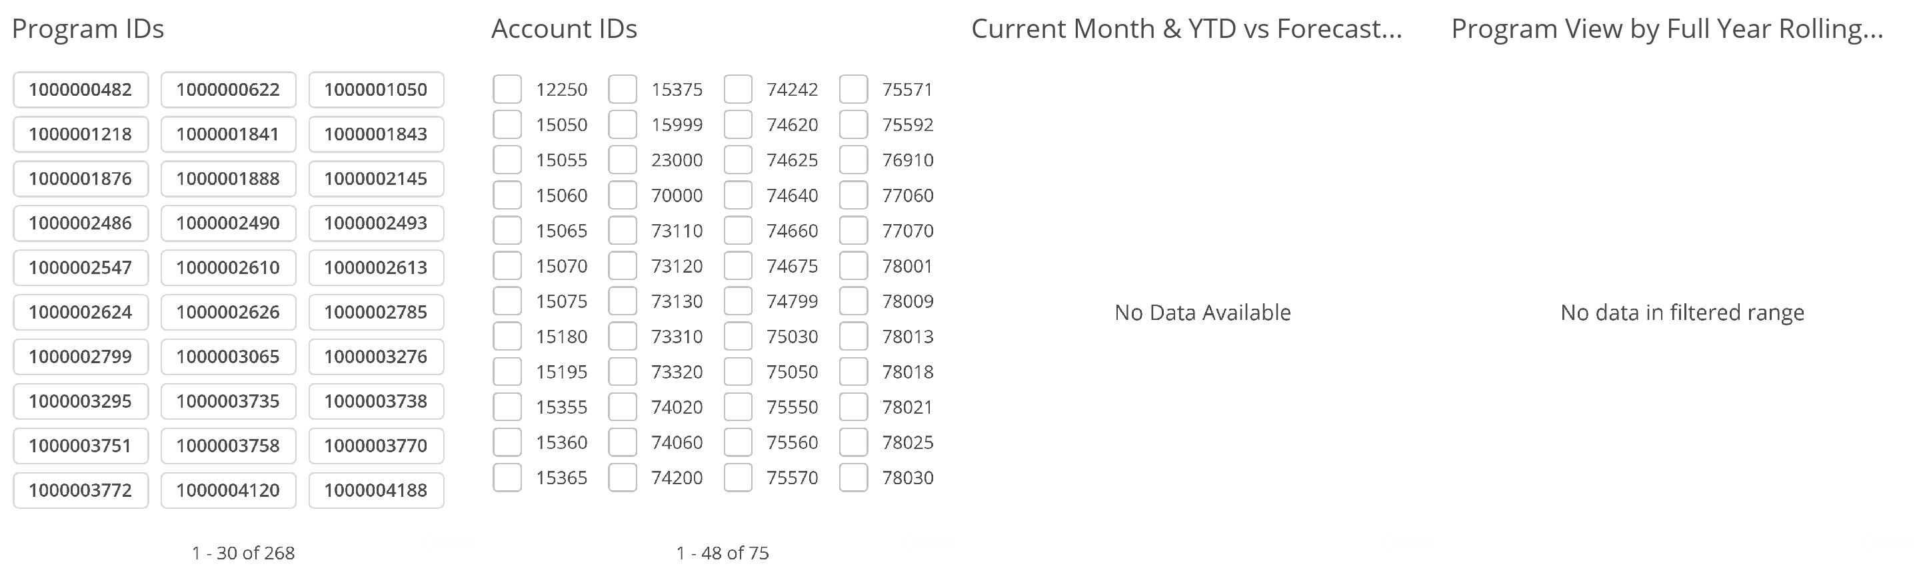
Appendix

Slide 6
